Slide 1
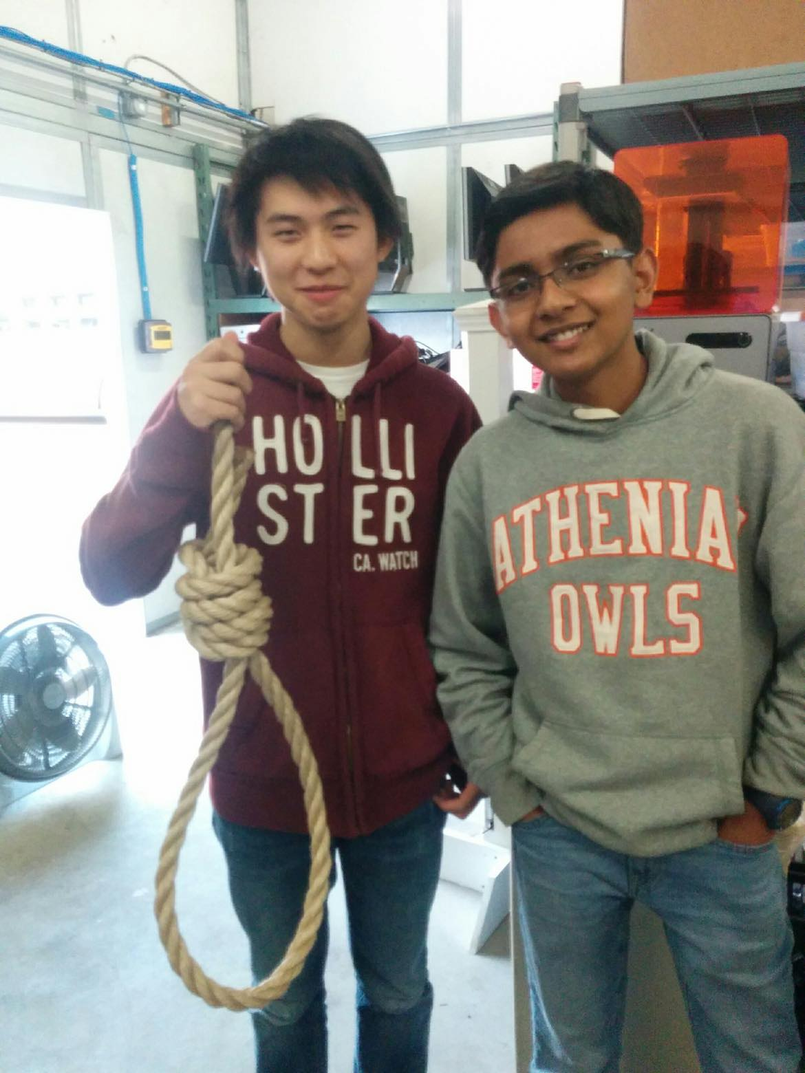

A RAFT-based key-value storage implementation
Donovan Zhong & Muhammad Qasim

Slide 2
Structure of implementation
Implementation built using gRPC
Request/Response system
Client requests, server responds
Problem: any server needs to have the capability to request as well as respond
Not possible with 1 gRPC connection

Slide 3
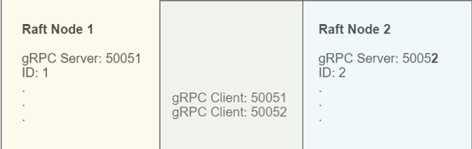
Solution & Structure
Each gRPC connection allows client to only talk to one single server.
Create n gRPC servers & n gRPC clients all in their own threads.
RaftNode class contains mains server and references to all threads (n clients) through the concurrent hashmap.
Seamless and, abstractly, as if every node can request and respond through one channel.

Slide 4
Structure (continued)
Shared values:
The gRPC client and servers need to have shared values between threads: thread safe data
AtomicIntegers to keep tracks of term, Concurrent Hashmap to keep track of Client

Slide 5
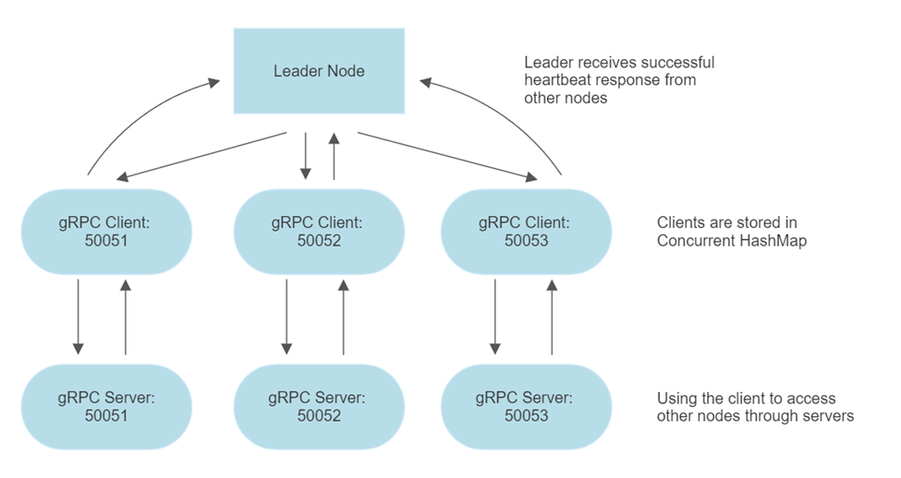
Communication

Slide 6
Communication (Continued)
This is how different Raft Server would communicate with each other
This is an example of the leader sending out heartbeat to its followers
It finds every client that it has access to, and make the clients send a request to their respective server
Server responds to client, client gets the response to Node, and Node save

Slide 7
Metrics and criteria
Goal: 0.5-20ms per heartbeat (optimal RAFT time)
ETCD implementation is much more complicated algorithms that include recursive gets and a tree structure.
So, 100ms per heartbeat in etcd.
Metrics:
Impact of increasing number of nodes: 4, 6, 8, and 10 nodes
Impact of increasing number of client put requests: 1, 5, 10, 20, and 50 requests

Slide 8
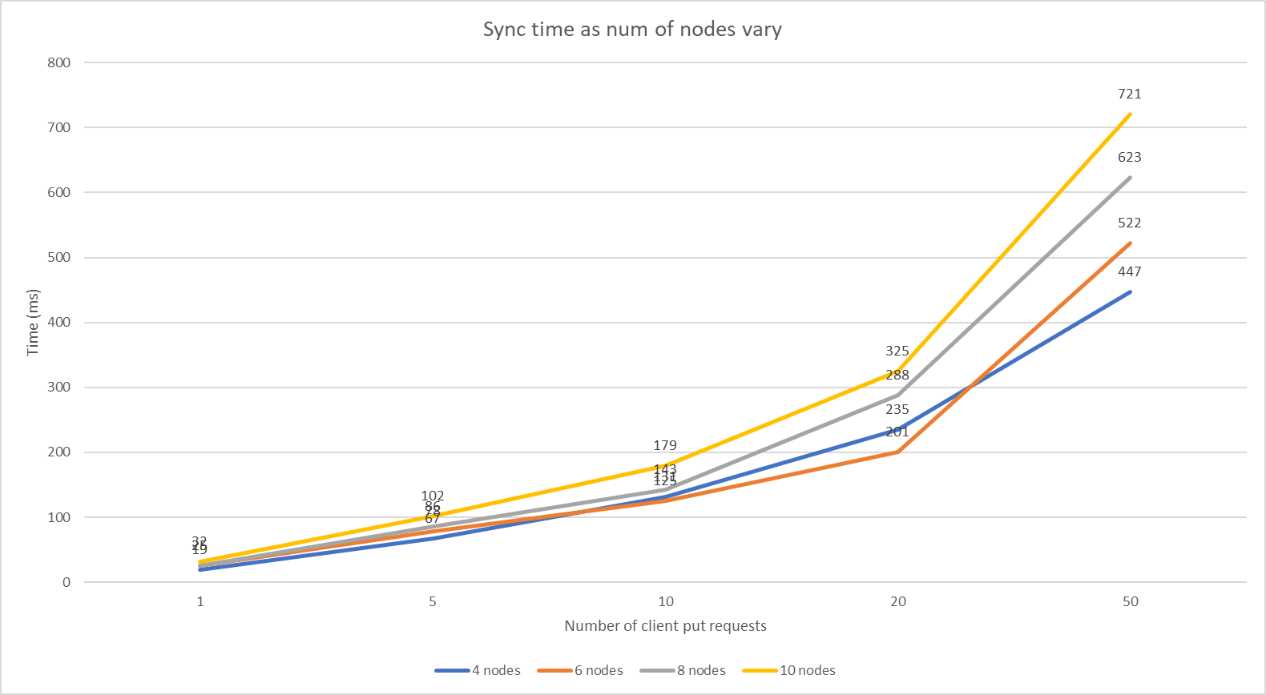
Results

Slide 9
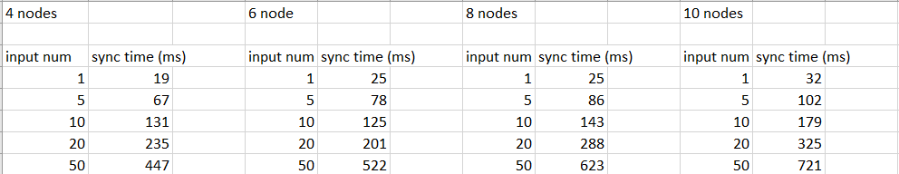
Evaluation

Slide 10
Conclusions
With 1 request, 19ms-32ms (very close to optimal)
Performs better than etcd (although less complicated storage algorithm)
Scales almost linearly in number of requests
Scales exponentially as number of nodes increases.

